Slide 1
Core Java 8
Lesson 14 : Collection

Slide 2
Lesson Objectives
After completing this lesson, participants will be able to
Understand collection framework
Implement and use collection classes
Iterate collections
Create collection of user defined type
Comparable and Comparator
HashTable, HashMap ,TreeMap
Notes:
This lesson discusses about collection framework in Java.
Lesson outline:
14.1: Collections Framework
14.2: Collection Interfaces
14.3: Implementing Classes
14.4: Iterating Collections
14.5: Comparable and Comparator
14.6 :HashTable ,HashMap TreeMap
14.7: Best Practices

Slide 3

14.1: Collections Framework Collections Framework
A Collection is a group of objects.
Collections framework provides a set of standard utility classes to manage collections.
Collections Framework consists of three parts:
Core Interfaces
Concrete Implementation
Algorithms such as searching and sorting
Notes:
Collections Framework:
A Collection (sometimes called a container) is an object that groups multiple elements into a single unit. Collection is used to store, retrieve objects, and to transmit them from one method to another.
The Collections API (also called the Collections framework) standardizes the way in which groups of objects are handled by your programs. It presents a set of standard utility classes to manage such collections. This framework is provided in the java.util package and comprises three main parts:
The core interfaces, which allow collections to be manipulated independent of their implementation. These interfaces define the common functionality exhibited by collections, and facilitate data exchange between collections.
A small set of implementations, which are concrete implementations of the core interfaces, providing data structures that a program can use. Eg LinkedLists, Arrays etc
An assortment of algorithms, which can be used to perform various operations on collections, such as sorting & searching.
The collection classes are the fundamental building blocks of the more complicated data structures used in the other Java packages in your own applications. There are several types of collections. They vary in storage mechanisms used, in the way they access data, and in the rules about what data may be stored.
Note: The Java Collection technology is similar to the Standard Template Library (STL) defined by C++.

Slide 4
14.1: Collections Framework Advantages of Collections
Collections provide the following advantages:
Reduces programming effort
Increases performance
Provides interoperability between unrelated APIs
Reduces the effort required to learn APIs
Reduces the effort required to design and implement APIs
Fosters Software reuse
Notes:
Collections Framework:
Advantages of Collections:
Collections provide the following advantages:
Reduces programming effort by providing useful data structures and algorithms so you do not have to write them yourself.
Increases performance by providing high-performance implementations of useful data structures and algorithms. Since the various implementations of each interface are interchangeable, programs can be easily tuned by switching implementations.
Provides interoperability between unrelated APIs by establishing a common language to pass collections back and forth.
Reduces the effort required to learn APIs by eliminating the need to learn multiple ad hoc collection APIs.
Reduces the effort required to design and implement APIs by eliminating the need to produce ad hoc collections APIs.
Fosters software reuse by providing a standard interface for collections and algorithms to manipulate them.

Slide 5
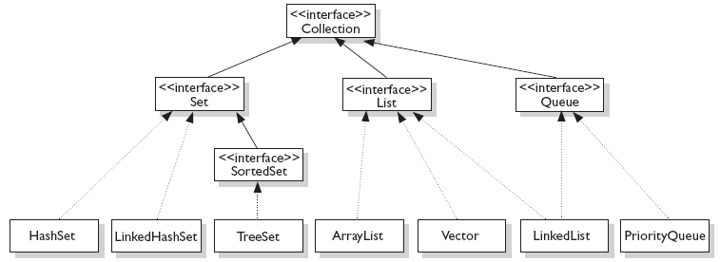
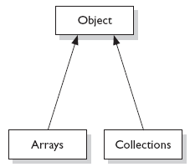
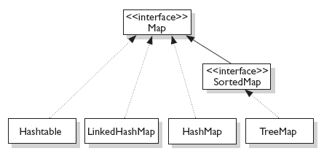


14.1: Collections Framework Concept of Interfaces and Implementation
Fig:1
Fig:3
Fig:2
Notes:
Interfaces and Implementation:
The core collection interfaces (shown in figure above) are the interfaces used to manipulate collections, and to pass them from one method to another. The basic purpose of these interfaces is to allow collections to be manipulated independently of the details of their representation.
Not all collections in the Collections Framework actually implement the Collection interface. Specifically, none of the Map-related classes and interfaces extend from Collection. So while SortedMap, Hashtable, HashMap, TreeMap, and LinkedHashMap are all thought of as collections, none are actually extended from Collection.
Note: Collections is a class, with static utility methods, while Collection is an interface with declarations of the methods common to most collections including add(), remove(), contains(), size(), and iterator().

Slide 6
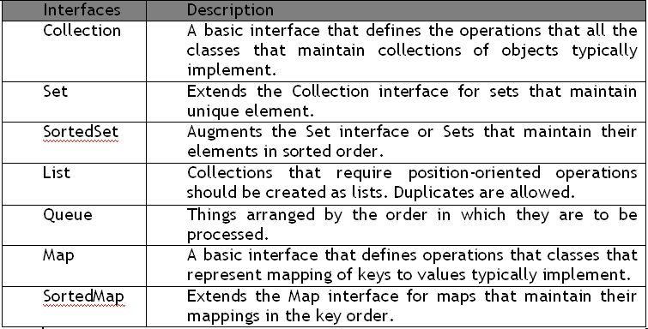
14.2: Collection Interfaces Collection Interfaces
Let us discuss some of the collection interfaces:
Notes:
Interfaces and Implementation:
Collection Interfaces:
Following are the four major interfaces:
Set Interface: holds only unique values and rejects duplicates.
List Interface: represents an ordered list of objects, meaning the elements of a List can be accessed in a specific order, and by an index too. List can hold duplicates.
Queue Interface: represents an ordered list of objects just like a List. However, a queue is designed to have elements inserted at the end of the queue, and elements removed from the beginning of the queue. Just like a queue in a supermarket!
Map Interface: represents a mapping between a key and a value. The Map interface is not a subtype of the Collection interface. A Map cannot contain duplicate keys; each key can map to at most one value. The Map implementations let you do things like search for a value based on the key, ask for a collection of just the values, or ask for a collection of just the keys.
SortedSet Interface: is a Set that maintains its elements in ascending order. Several additional operations are provided to take advantage of the ordering.
SortedMap Interface: is a Map that maintains its mappings in ascending key order. This is the Map analog of SortedSet. Sorted maps are used for naturally ordered collections of key/value pairs, such as dictionaries and telephone directories.

Slide 7
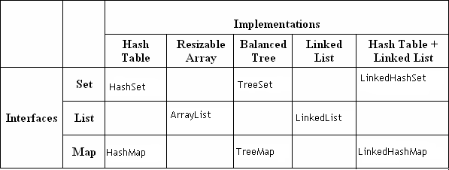
14.2: Collection Interfaces Collection Implementations
Collection Implementations:
Notes:
Collection Implementations:
The Java Collections Framework provides several general-purpose implementations of the Set, List, and Map interfaces. The general purpose implementations are summarized in the table above.
HashSet: is an unsorted, unordered Set. It uses the hashcode of the object being inserted, so the more efficient your hashCode() implementation is, the better access performance you will get. Use this class when you want a collection with no duplicates and you do not care about order when you iterate through it. Implements the Set interface.
LinkedHashSet: differs from HashSet by guaranteeing that the order of the elements during iteration is the same as the order they were inserted into the LinkedHashSet.
TreeSet: implements the SortedSet interface. Like LinkedHashSet, TreeSet also guarantees the order of the elements when iterated, but the order is the sorting order of the elements. This order is determined either by their natural order (if they implement Comparable), or by a specific Comparator implementation.
ArrayList: Think of this as a growable array. It gives you fast iteration and fast random access. It is an ordered collection (by index). However, it is not sorted. ArrayList now implements the new RandomAccess interface — a marker interface (meaning it has no methods) that says, “this list supports fast (generally constant time) random access.” Choose this over a LinkedList when you need fast iteration but are not as likely to be doing a lot of insertion and deletion.
LinkedList: A LinkedList is ordered by index position, like ArrayList, except that the elements are doubly-linked to one another.

Slide 8
14.2: Collection Interfaces Collection Implementations
Notes Page
Notes:
Collection Implementations (contd.):
This linkage gives you new methods (beyond what you get from the List interface) for adding and removing from the beginning or end. This makes it an easy choice for implementing a stack or queue. Keep in mind that a LinkedList may iterate more slowly than an ArrayList. However, it is a good choice when you need fast insertion and deletion. As of Java 5, the LinkedList class has been enhanced to implement the java.util.Queue interface. As such, it now supports the common queue methods: peek(), poll(), and offer().
HashMap: The HashMap gives you an unsorted, unordered Map. When you need a Map and you do not care about the order (when you iterate through it), then HashMap is the way to go. The other maps add a little more overhead. Where the keys land in the Map is based on the key’s hashcode. So, like HashSet, the more efficient your hashCode() implementation, the better access performance you will get. HashMap allows one null key and multiple null values in a collection.
TreeMap: TreeMap is a sorted Map.
LinkedHashMap: Like its Set counterpart, LinkedHashSet, the LinkedHash-Map collection maintains insertion order (or, optionally, access order). Although it will be somewhat slower than HashMap for adding and removing elements, you can expect faster iteration with a LinkedHashMap.

Slide 9
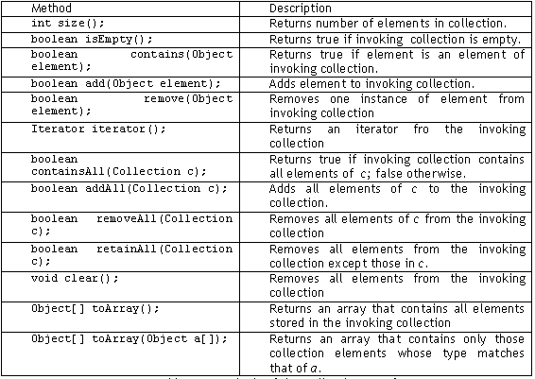
14.2: Collection Interfaces Collection Interface methods
Notes:
Collection Interface Methods:
The Collection Interface is the foundation on which the collection framework is built. It declares the core methods that all collections will have. Some of these methods are summarized in the table given in the above slide.
The bulk operations perform some operation on an entire Collection in a single shot. They are done through the following methods, namely: containsAll(), addAll(), removeAll(), retainAll(), clear().

Slide 10
14.3: AutoBoxing with Collections AutoBoxing with Collections
Boxing conversion converts primitive values to objects of corresponding wrapper types.
Unboxing conversion converts objects of wrapper types to values of corresponding primitive types.
int intVal = 14;
Integer iReference = new Integer(i); // prior to Java 5, explicit Boxing
iReference = intVal; // In Java 5,Automatic Boxing
int intVal = iReference.intValue(); // prior to Java5, explicit unboxing
intVal = iReference; // In Java 5, Automatic Unboxing
Notes:
AutoBoxing with Collections:
J2SE 5 adds to the Java language autoboxing and auto-unboxing.
Primitive types and their corresponding wrapper classes can now be used interchangeably. For example: The following lines of code are legitimate in Java 5:
This is often referred to as automatic boxing or unboxing.
If an int is passed where an Integer is expected, then the compiler will automatically insert a call to the Integer constructor. Conversely, if an Integer is provided where an int is required, then there will be an automatic call to the IntValue method.
Autoboxing is the process by which a primitive type is automatically encapsulated into its equivalent type wrapper whenever an object of that type is needed.
Auto-unboxing is the process by which the value of a boxed object is automatically extracted (unboxed) from type wrapper when its value is needed.
int intval1 = 0;
Integer intval2 = intval1;
int intval3 = new Integer(intval2);

Slide 11
14.3: Iterating Collection Iterating through a collection
Iterator is an object that enables you to traverse through a collection.
It can be used to remove elements from the collection selectively, if desired.
Iterable is an superinterface of Collection interface, allows to iterate the elements using foreach method
public interface Iterator<E>
{
boolean hasNext();
E next();
void remove();
}
Collection.forEach(Consumer<? super T> action)
Notes:
Iterators:
Java provides two interfaces that define the methods by which you can access each element of a collection: Enumeration and Iterator.
Enumeration is a legacy interface and is considered obsolete for new code. It is now superseded by the iterator interface.
The iterator() method of every collection returns an iterator to a collection. It is similar to an Enumeration, but differs in two respects:
Iterator allows the caller to remove elements from the underlying collection during the iteration with well-defined semantics.
Method names have been improved.
There is no safe way to remove elements from a collection while traversing it with an Enumeration.
In the example in the above slide, the following parameters are used:
boolean hasNext() : returns true if there are more elementsObject
next() : It returns next element. It throws NoSuchElementException if there is no next element.
void remove() : It removes current element. Throws IllegalStateException if an attempt is made to call remove() that is not preceded by a call to next()
Note 1: The hasNext() method is identical in function to Enumeration.hasMoreElements(), and the next() method is identical in function to Enumeration.nextElement().
Note 2: Iterator.remove() is the only safe way to modify a collection during iteration. The behavior is unspecified if the underlying collection is modified in any other way while the iteration is in progress.

Slide 12
14.3: Iterating Collection Enhanced for loop
Iterating over collections looks cluttered:
Using enhanced for loop, we can do the same thing as:
When you see the colon (:) read it as “in.”
The loop above reads as “for each emp ‘t’ in collection ‘e’.”
void printAll(Collection<Emp> employees) {
for (Iterator<Emp> iterator = employees.iterator();
iterator.hasNext(); )
System.out.println(iterator.next()); } }
void printAll(Collection<Emp> employees) {
for (Emp empObj : employees) )
System.out.println( empObj ); }}
Notes:
Enhanced for loop:
The enhanced for loop can be used for both Arrays and Collections:
class Enhancedforloop {
static void printArray(int intArr[]) {
for (int arrayindex : intArr )
System.out.println(arrayindex);
}
static void printCollection(ArrayList arrList) {
for (Object object : arrList)
System.out.println(object);
}
public static void main(String arg[]) {
int intArr[] = { 1, 2, 3, 4, 5 };
printArray(intArr);
ArrayList arraylist = new ArrayList();
arraylist.add(10);
arraylist.add(30);
arraylist.add(20);
printCollection(arraylist);
}
}

Slide 13
14.3: Iterating Collection Demo :Concept of Iterators
Execute:
MailList.java
ItTest.java program

Slide 14
14.4: Implementing Classes ArrayList Class
An ArrayList Class can grow dynamically.
It provides more powerful insertion and search mechanisms than arrays.
It gives faster Iteration and fast random access.
It uses Ordered Collection (by index), but not Sorted.
ArrayList<Integer> list = new ArrayList<Integer>();
list.add(0, new Integer(42));
int total = list.get(0).intValue();
Notes:
ArrayList Class:
Let us check the power of ArrayList with an example:
List<String> myList = new ArrayList<String>();
In many ways, ArrayList<String> is similar to a String[] in that it declares a container that can hold only Strings. However, it is more powerful than a String[]. Let us look at some of the capabilities that an ArrayList has:
import java.util.*;
public class ArrayListTest {
public static void main(String[] args) {
List<String> list = new ArrayList<String>();
String str = "hi";
list.add("string");
list.add(str);
list.add(str + str);
System.out.println(list.size());
System.out.println(list.contains(42));
System.out.println(list.contains("hihi"));
list.remove("hi");
System.out.println(list.size());
}
}
output :
3
false
true
2

Slide 15
14.4: Implementing Classes Vector Class
Vector implements a dynamic array. It is similar to ArrayList, but with two differences −
Vector is synchronized.
Vector contains many legacy methods that are not part of the collections framework.
Vector proves to be very useful if you don't know the size of the array in advance or you just need one that can change sizes over the lifetime of a program.
Notes:
ArrayList Class:
Let us check the power of ArrayList with an example:
List<String> myList = new ArrayList<String>();
In many ways, ArrayList<String> is similar to a String[] in that it declares a container that can hold only Strings. However, it is more powerful than a String[]. Let us look at some of the capabilities that an ArrayList has:
import java.util.*;
public class ArrayListTest {
public static void main(String[] args) {
List<String> list = new ArrayList<String>();
String str = "hi";
list.add("string");
list.add(str);
list.add(str + str);
System.out.println(list.size());
System.out.println(list.contains(42));
System.out.println(list.contains("hihi"));
list.remove("hi");
System.out.println(list.size());
}
}
output :
3
false
true
2

Slide 16
14.4: Implementing Classes Demo: Vector Class
Execute the VectorDemo.java program

Slide 17
14.4: Implementing Classes HashSet Class
HashSet Class does not allow duplicates.
A HashSet is an unsorted, unordered Set.
It can be used when you want a collection with no duplicates and you
do not care about the order when you iterate through it.
Notes:
HashSet Class:
Remember that Sets are used when you do not want any duplicates in your collection. If you attempt to add an element to a set that already exists in the set, then the duplicate element will not be added, and the add() method will return false.
Remember, HashSets tend to be very fast because they use hashcodes.
O/P: 2 4 1 3 5
Note: The order of the objects printed are not predictable
import java.util.*;
class SetTest {
public static void main(String[] args) {
boolean[] boolArr = new boolean[5];
Set<Integer> set = new HashSet<Integer>();
boolArr[0] = set.add(1);
boolArr[1] = set.add(2);
boolArr[2] = set.add(3);
boolArr[3] = set.add(4);
boolArr[4] = set.add(5);
for (Integer index : set)
System.out.print(index + " ");
}
}

Slide 18
14.4: Implementing Classes Demo: Hash Set Class
Execute the HashSetDemo.java program
Notes:
Output :
[D, A, F, C, B, E]
import java.util.*;
class HashSetDemo {
public static void main(String args[]) {
// create a hash set
HashSet hs = new HashSet();
// add elements to the hash set
hs.add("B");
hs.add("A");
hs.add("D");
hs.add("E");
hs.add("C");
hs.add("F");
System.out.println(hs);
}
}

Slide 19
14.4: Implementing Classes TreeSet class
TreeSet does not allow duplicates.
It iterates in sorted order.
Sorted Collection:
By default elements will be in ascending order.
Not synchronized:
If more than one thread wants to access it at the same time, then it must be synchronized externally.
Notes:
TreeSet:
TreeSet implements the Set interface, backed by a TreeMap instance. This class guarantees that the sorted set will be in ascending element order, sorted according to the natural order of the elements, or by the comparator provided at set creation time, depending on which constructor is used.
O/P: Five Four One Three Two
class TreeSetDemo {
public static void main(String args[]) {
TreeSet<String> treeSet = new TreeSet<String>();
treeSet.add("One");
treeSet.add("Two");
treeSet.add("Three");
treeSet.add("Four");
treeSet.add("Five");
System.out.println("Contents of treeset");
Iterator iterator = treeSet.iterator(); // obtaining iterator object
while (iterator.hasNext()) { // to iterate thru collection.
Object object = iterator.next();
System.out.print(object + "\t");
}
}}

Slide 20
14.4: Implementing Classes Demo: Tree Set class
Execute the Treeset.java program
Notes:
You can also refer to the

Slide 21
14.5: Comparable and Comparator Comparator Interface
The java.util.Comparator interface can be used to sort the elements of an Array or a list in the required way.
It gives you the capability to sort a given collection in any number of different ways.
Methods defined in Comparator Interface are as follows:
int compare(Object o1, Object o2)
It returns true if the iteration has more elements.
boolean equals(Object obj)
It checks whether an object equals the invoking comparator.
Notes:
Comparator Interface:
The Comparator interface defines two methods: compare( ) and equals( ).
The compare( ) method, shown here, compares two elements for order:
int compare(Object obj1, Object obj2)
obj1 and obj2 are the objects to be compared. This method returns zero if the objects are equal. It returns a positive value if obj1 is greater than obj2. Otherwise, a negative value is returned. The method can throw a ClassCastException if the types of the objects are not compatible for comparison.
By overriding compare( ), you can alter the way that objects are ordered. For example, to sort in reverse order, you can create a comparator that reverses the outcome of a comparison.
The equals( ) method, shown here, tests whether an object equals the invoking comparator:
boolean equals(Object obj)
obj is the object to be tested for equality. The method returns true if obj and the invoking object are both Comparator objects and use the same ordering. Otherwise, it returns false. Overriding equals( ) is unnecessary, and most simple comparators will not do so.

Slide 22
14.5: Comparable and Comparator Comparable Interface
Java.util.Comparable interface imposes a total ordering on the objects of each class that implements it.
This ordering is referred to as the class's natural ordering, and the class's compareTo method is referred to as its natural comparison method.
Methods defined in Comparable Interface are as follows:
public int compareTo(Object o)
Compares this object with the specified object for order. Returns a negative integer, zero, or a positive integer as this object is less than, equal to, or greater than the specified object.
Notes:
Comparable Interface:
This interface imposes a total ordering on the objects of each class that implements it. This ordering is referred to as the class's natural ordering, and the class's compareTo method is referred to as its natural comparison method.
Lists (and arrays) of objects that implement this interface can be sorted automatically by Collections.sort (and Arrays.sort). Objects that implement this interface can be used as keys in a sorted map or elements in a sorted set, without the need to specify a comparator.
public int compareTo(Object o)
Compares this object with the specified object for order. Returns a negative integer, zero, or a positive integer as this object is less than, equal to, or greater than the specified object.

Slide 23
14.5: Comparable and Comparator Comparable Interface Example
class Emp implements Comparable {
int empID;
String empName;
double empSal;
public Emp(String ename, double sal) { … }
public String toString() { … }
public int compareTo(Object o) {
if (this.empSal == ((Emp) o).empSal) return 0;
else if (this.empSal > ((Emp) o).empSal) return 1;
else return -1;
}}

Slide 24
14.5: Comparable and Comparator Comparable Interface Example (ctnd…)
class Comparable Demo {
public static void main(String[] args) {
TreeSet tset = new TreeSet();
tset.add(new Emp("harry", 40000.00));
tset.add(new Emp("Mary", 20000.00));
tset.add(new Emp("Peter", 50000.00));
Iterator iterator = tset.iterator();
while (iterator.hasNext()) {
Object empObj = iterator.next();
System.out.println(empObj + "\n");
}
}}
Output:
Ename : Mary Sal : 20000.0
Ename : harry Sal : 40000.0
Ename : Peter Sal : 50000.0

Slide 25
14.5: Comparable and Comparator Demo : Concept of Comparator & Comparable Interface
Execute:
ComparatorExample.java
ComparableDemo.java

Slide 26
14.6: Map implementation HashMap Class
HashMap uses the hashcode value of an object to determine how the object should be stored in the collection.
Hashcode is used again to help locate the object in the collection.
HashMap gives you an unsorted and unordered Map.
It allows one null key and multiple null values in a collection.
Notes:
HashMap Class:
Map is an object that stores key/value pairs. Given a key, you can find its value. Keys must be unique, values may be duplicated. The HashMap class implements the map interface. The HashMap class uses a hash table to implement Map interface.
The following example maps names to account balances.
import java.util.*;
class HashMapDemo {
public static void main(String args[]) {
HashMap<String,Double> hm = new HashMap<String,Double>();
hm.put("John Doe", new Double(3434.34));
hm.put("Tom Smith", new Double(123.22));
hm.put("Jane Baker", new Double(1378.00));
hm.put("Tod Hall", new Double(99.22));
hm.put("Ralph Smith", new Double(-19.08));
Set set = hm.entrySet(); // Get a set of the entries
Iterator i = set.iterator(); // Get an iterator
while(i.hasNext()) { // Display elements
Map.Entry me = (Map.Entry)i.next();
System.out.println(me.getKey() + ": "+ me.getValue());
}
// Deposit 1000 into John Doe's account
double balance = ((Double)hm.get("John Doe")).doubleValue();
hm.put("John Doe", new Double(balance + 1000));
System.out.println("John Doe's new balance: " + hm.get("John Doe")); } }

Slide 27
14.6: Map implementation Internal Working of HashMap
HashMap works on the principal of hashing.
HashMap uses the hashCode() method to calculate a hash value. Hash value is calculated using the key object. This hash value is used to find the correct bucket where Entry object will be stored.
HashMap uses the equals() method to find the correct key whose value is to be retrieved in case of get() and to find if that key already exists or not in case of put().
Hashing collision means more than one key having the same hash value, in that case Entry objects are stored as a linked-list with in a same bucket.
With in a bucket values are stored as Entry objects which contain both key and value.
Notes:
import java.util.*;
class HashMapDemo {
public static void main(String args[]) {
HashMap<String,Double> hm = new HashMap<String,Double>();
hm.put("John Doe", new Double(3434.34));
hm.put("Tom Smith", new Double(123.22));
hm.put("Jane Baker", new Double(1378.00));
hm.put("Tod Hall", new Double(99.22));
hm.put("Ralph Smith", new Double(-19.08));
Set set = hm.entrySet(); // Get a set of the entries
Iterator i = set.iterator(); // Get an iterator
while(i.hasNext()) { // Display elements
Map.Entry me = (Map.Entry)i.next();
System.out.println(me.getKey() + ": "+ me.getValue());
}
// Deposit 1000 into John Doe's account
double balance = ((Double)hm.get("John Doe")).doubleValue();
hm.put("John Doe", new Double(balance + 1000));
System.out.println("John Doe's new balance: " + hm.get("John Doe")); } }

Slide 28
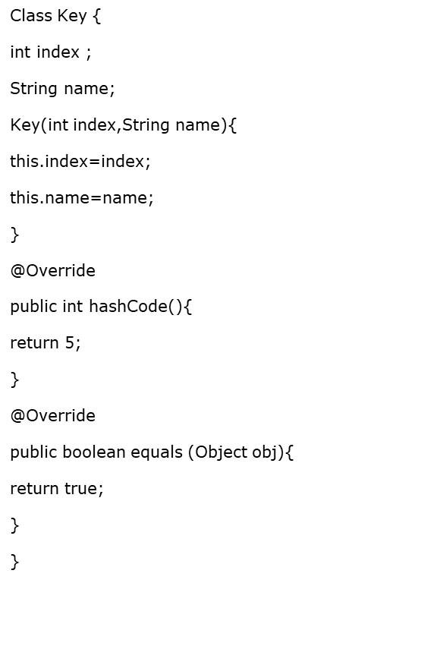
14.6: Map implementation Internal Working of HashMap
public class Demo{
public static void main(String args[]){
Map <Key, String> cityMap = new HashMap<Key, String>();
cityMap.put(new Key(1, "NY"),"New York City" );
cityMap.put(new Key(2, "ND"), "New Delhi");
cityMap.put(new Key(3, "NW"), "Newark");
cityMap.put(new Key(4, "NP"), "Newport");
System.out.println("size :”+ cityMap.size());
Iterator <Key> itr = cityMap.keySet().iterator();
while (itr.hasNext()){
System.out.println(cityMap.get(itr.next()));
}
System.out.println("size after iteration " + cityMap.size());
}
}
Output :
Size before iteration : 1
Newport
Size after iteration : 1

Slide 29
14.6: Map implementation Demo: HashMap Class
Execute the HashMapDemo.java program
Notes:
The example is provided on previous page.
The output of the program is as follows:
Ralph Smith: -19.08
Tom Smith: 123.22
John Doe: 3434.34
Tod Hall: 99.22
Jane Baker: 1378.0
John Doe’s new balance: 4434.34
The above program first populates the HashMap object. Then the contents of the map are displayed using a set-view, obtained by calling entrySet(). The keys and values are displayed by calling getKey() and getValue() methods of the Map.Entry interface.
Note: TreeMap instead of HashMap will have given a sorted output.

Slide 30
14.6: Map Implementation Hashtable Class
Hashtable was part of the original java.util and is a concrete implementation of a Dictionary
Hashtable is now integrated into the collections framework. It is similar to HashMap, but is synchronized.
Like HashMap, Hashtable stores key/value pairs in a hash table. When using a Hashtable, you specify an object that is used as a key, and the value that you want linked to that key. The key is then hashed, and the resulting hash code is used as the index at which the value is stored within the table.
Notes:
Hashtable Class:
The Hashtable was a part of the original java.util package.
Hashtable is synchronized, and stores a key/value pair using the hashing technique.
While using a Hashtable, you specify an object that is used as a key, and the value that you want linked to that key. The key is then hashed. Subsequently, the resulting hash code is used as the index at which the value is stored within the table. The Hashtable class only stores objects that override the hashCode() and equals() methods that are defined by Object.

Slide 31
14.7: The Legacy Classes Demo: Hash table Class
Execute the HashTableDemo.java program
Notes:
import java.util.*;
class HashTableDemo {
public static void main(String args[]) {
Hashtable<String,Double> balance = new
Hashtable<String,Double>();
Enumeration names;
String str;
double bal;
balance.put("Arun", new Double(3434.34));
balance.put("Radha", new Double(123.22));
balance.put("Ram", new Double(99.22));
// Show all balances in hash table.
names = balance.keys();
while(names.hasMoreElements()) {
str = (String) names.nextElement();
System.out.println(str + ": " +
balance.get(str));
}
// Deposit 1,000 into Zara's account
bal = ((Double)balance.get("Ram")).doubleValue();
balance.put("Ram", new Double(bal+1000));
System.out.println("Ram's new balance: " +
balance.get("Ram"));
}
}

Slide 32
14.6: Map implementation TreeMap Class
The TreeMap class implements the Map interface by using a tree. A TreeMap provides an efficient means of storing key/value pairs in sorted order, and allows rapid retrieval.
You should note that, unlike a hash map, a tree map guarantees that its elements will be sorted in an ascending key order.
Notes:
HashMap Class:
Map is an object that stores key/value pairs. Given a key, you can find its value. Keys must be unique, values may be duplicated. The HashMap class implements the map interface. The HashMap class uses a hash table to implement Map interface.
The following example maps names to account balances.
import java.util.*;
class HashMapDemo {
public static void main(String args[]) {
HashMap<String,Double> hm = new HashMap<String,Double>();
hm.put("John Doe", new Double(3434.34));
hm.put("Tom Smith", new Double(123.22));
hm.put("Jane Baker", new Double(1378.00));
hm.put("Tod Hall", new Double(99.22));
hm.put("Ralph Smith", new Double(-19.08));
Set set = hm.entrySet(); // Get a set of the entries
Iterator i = set.iterator(); // Get an iterator
while(i.hasNext()) { // Display elements
Map.Entry me = (Map.Entry)i.next();
System.out.println(me.getKey() + ": "+ me.getValue());
}
// Deposit 1000 into John Doe's account
double balance = ((Double)hm.get("John Doe")).doubleValue();
hm.put("John Doe", new Double(balance + 1000));
System.out.println("John Doe's new balance: " + hm.get("John Doe")); } }

Slide 33
14.6: Map implementation Demo: TreeMap Class
Execute the TreeMapDemo.java program

Slide 34
Lab
Lab 7: Arrays and Collections

Slide 35
14.8: Common Best Practices on Collections Best Practices
Let us discuss some of the best practices on Collections:
Use for-each liberally.
Presize collection objects.
Note that Vector and HashTable is costly.
Note that LinkedList is the worst performer.
Notes:
Common Best Practices on Collections:
Use for-each liberally : When there is a choice, the for-each loop should be preferred over the for loop, since it increases legibility.
Presize collection objects.
This is necessary because whenever the collection size has reached the maximum, internally whole array is copied to a new array with new increased size. This takes considerable time.
Try to presize any collection object to be as big as it will need to be. It is better for the object to be slightly bigger than necessary than to be smaller. This recommendation really applies to collections that implement size increases in such a way that objects are discarded.
For example: Vector grows by creating a new larger internal array object, copying all the elements from and discarding the old array. Most collection implementations work similarly, so presizing a collection to its largest potential size reduces the number of objects discarded.
Vector and HashTable is costly.
Usage of vector is very costly especially in code which heavily uses Vector to store lots of elements. Avoid using that if the elements in it are of same type. This is because elements are stored as Object so while accessing them one has to cast them into relevant classes which is very costly. Use ArrayList instead.
HashTable has the same reason as in the case of Vector. Moreover, the problem is compounded because of the use of Key and Value. Use HashMap class instead.
Never use linked List while accessing the objects : Sequentially access the elements.

Slide 36
14.8: Common Best Practices on Collections Best Practices
Choose the right Collection.
Note that adding objects at the beginning of the collections is considerably slower than adding at the end.
Encapsulate collections.
Use thread safe collections when needed.
Notes:
Common Best Practices on Collections:
Choosing the right Collection:
We can select the appropriate collection based on the different implementation of the collection interfaces. As we know, there are different collection classes available such as ArrayList, LinkedList, HashSet, TreeSet, HashMap, TreeMap, and so on.
Principal features of non-primary implementations:
HashMap has slightly better performance than LinkedHashMap. However, its iteration order is undefined.
HashSet has slightly better performance than LinkedHashSet. However its iteration order is undefined.
TreeSet is ordered and sorted, but slow.
TreeMap is ordered and sorted, but slow.
LinkedList has fast adding to the start of the list, and fast deletion from the interior via iteration.

Slide 37
14.8: Common Best Practices on Collections Best Practices
Notes page
Notes:
Common Best Practices on Collections (contd.):
Iteration order for above implementations:
HashSet - undefined
HashMap - undefined
LinkedHashSet - insertion order
LinkedHashMap - insertion order of keys (by default), or “access order”
ArrayList - insertion order
LinkedList - insertion order
TreeSet - ascending order, according to Comparable / Comparator
TreeMap - ascending order of keys, according to Comparable / Comparator
For LinkedHashSet and LinkedHashMap, the re-insertion of an item does not affect insertion order.
For LinkedHashMap, “access order” is from the least recent access to the most recent access. In this context, only calls to get, put, and putAll constitute an access, and only calls to these methods affect access order.
While being used in a Map or Set, these items must not change state (hence, it is recommended that these items be immutable objects):
keys of a Map
items in a Set
Adding objects at the beginning of the collections is considerably slower than adding at the end
For example: Adding 50000 objects (strings) in ArrayList at the end takes around 195 millis and adding at the beginning of ArrayList takes over 5000 millis.
JDK1.3 gives the best and very optimized performance when it comes to collections. Similarly removing objects from end takes less time than removing from start.
Encapsulate collections:
In general, Collections are not immutable objects. As such, one must often exercise care that collection fields are not unintentionally exposed to the caller.
One technique is to define a set of related methods which prevent the caller from directly using the underlying collection, such as :
addThing(Thing)
removeThing(Thing)
getThings() - return an unmodifiable Collection
Use thread safe collections when needed:
Collection classes which have the synchronized methods are always thread safe. Next slide gives the list of the synchronized and non-synchronized collections.

Slide 38
Summary
The various Collection classes and Interfaces
Generics
Best practices in Collections

Slide 39
Review Questions
Question 1: Consider the following code:
Option 1: Compilation fails
Option 2: four three two one
Option 3: one two three four
Option 4: four one three two
TreeSet map = new TreeSet();
map.add("one");
map.add("two");
map.add("three");
map.add("one");
map.add("four");
Iterator it = map.iterator();
while (it.hasNext() )
System.out.print( it.next() + " " );

Slide 40
Review Questions
Question 2: Which of the following statements are true for the given code?
Option 1: The before() method will print 1 2
Option 2: The before() method will print 1 2 3
Option 3: The before() method will not compile.
Option 4: The before() method will throw an exception at runtime.
public static void before() {
Set set = new TreeSet();
set.add("2");
set.add(3);
set.add("1");
Iterator it = set.iterator();
while (it.hasNext())
System.out.print(it.next() + " ");
}

